Slide 1

Understanding Stanford 10 Results
A Presentation for Parents and Guardians

Slide 2
Why is Testing Important?
It helps the teachers identify how to guide their overall classroom instruction.
It helps the teachers document student growth over time.
Testing helps the school to evaluate programs and make decisions about how to use time, personnel, and resources.

Slide 3

How the Stanford 10 Helps
The Stanford 10 provides important information about each student’s strengths and needs.

Slide 4
Stanford 10
Aligned with Common Core State Standards
Shows what students can do and what they know
Provides information about student progress towards academic achievement

Slide 5
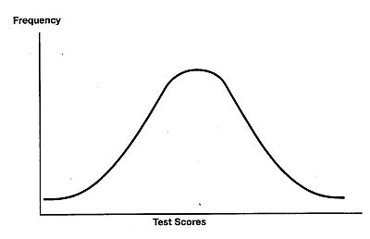
How the Stanford 10 Compares Students
Most scores on the test are norm referenced scores.
Norm referenced describes how each student did compared with other students in the same grade across the nation who took the same test at the same time in the school year.

Slide 6
Things to remember
This one test does not tell you everything about your student.
This is only one piece of information, from one point in time.
You need to look at a body of evidence to see how each student is doing. This includes classroom assignments, homework, projects, tests, grades, etc.
It is important to communicate how your students learns best to his/ her teacher.

Slide 7
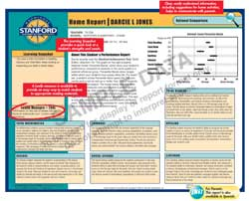
Home Report
Available in English or Spanish
The National Grade Percentile Bands for each content area tested are provided in a bar graph format
Provides an explanation of a student’s performance
Explains the content of each subtest and the student’s performance relative to a norm group
Suggestions are also provided for activities in each content area which the parent can use to encourage the student

Slide 8
What does Percentile Rank Mean?
A percentile is a score that indicates the rank of the students compared to others, same age or same grade, using a hypothetical group of 100 students.
A percentile of 25, for example, indicates that the student’s test performance equals or exceeds 25 out of 100 students on the same measure.

Slide 9
What are National Grade Percentile Bands?
Permit quick identification of a student’s relative strength and weaknesses by subject area or domain

Slide 10

How can I help my child?
Work together with your school to identify how your child learns best.
Be a model-If you show that you value learning, your child will too!
Provide support- Provide a quiet place to study, help when needed and set reasonable expectations.
Make reading a priority at home.

Slide 11

How can I help my child?
Stay informed.
Get to know your child’s textbooks.
Look at daily homework.
Keep in touch with your child’s teacher.
Attend school activities.

